Slide 1

Redco Developments: Network Design & Implementation Project
Name: Fathima Sameeha Rimzan
ID: E244970
Tutor: Mr. Lahiru
Unit name: Networking
Notes:
Good morning, im sameeha, In this presentation, I’ll be explaining the network design and implementation project for Redco Developments.

Slide 2
Content
1 Overview of Redco
2 Network Type
3 Devices and Tools Used in Redco Project
4 Security & Access Technologies in Redco’s Network
5 Network Blueprint of Redco developments
6 Cisco Packet Tracer Implementation
7 IP Ping Testing
8 Packet Tracer Test Cases
9 virtual box
10 Active Directory Setup in VirtualBox
11 References
12 Conclusion
Notes:
And today we will be going through these, overview of redco, network,

Slide 3

Overview of Redco
Redco Developments is a Sri Lankan-based mobile app development company with its head office in Kandy and has recently approved the opening of a new branch in Galle.
1 What is a network?
A computer network is a system where multiple computers and other digital devices are connected to share information and resources and these devices are connected using communication media like Wi-Fi (TechTarget, 2023).
2 Use and benefits of network
The main use of a computer network is to allow data to be exchanged through sharing of information such as files, applications, and hardware devices like printers, or storage devices
Shared hardware like printers and files
Centralized management
Flexibility
Easy communication
Notes:
before diving into the network design, let me briefly introduce the company. Redco Developments is a leading mobile app development company based in Sri Lanka, with its head office located in Kandy, and a new branch in Galle as well. The company focuses on creating high-quality mobile applications for top-tier clients.
A network is basically a group of devices like computers, servers, and printers that are connected to share information. There are different types of networks depending on the size and distance.
Employees from different department can share their printers and files with other departments and this will reduce redcos expenses, as multiple printers do not have to be purchased
Centralized management, means passwords and permission can be managed from a single location, giving the company full control
Flexibility, redco can easily add new branches and department without having to redo the entire network
Easy communication for example branches can easily communicate, anywhere anytime, and the team can have video conferencing as well

Slide 4
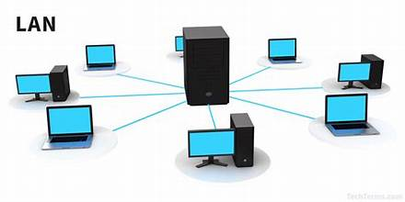
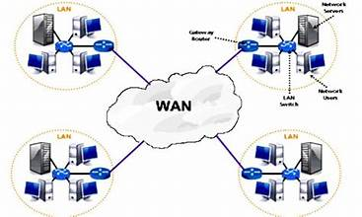
Network Type
Types of network
2.1 LAN (Local Area Network) – Covers small areas like offices or buildings, it connects PCs, printers, and servers within short distances and is very fast and affordable.
2.2 WAN (Wide Area Network)- connects networks over long distances, like department in Galle and Kandy. The biggest example of WAN is the internet.
Notes:
Types of network
At first, we have LAN

Slide 5
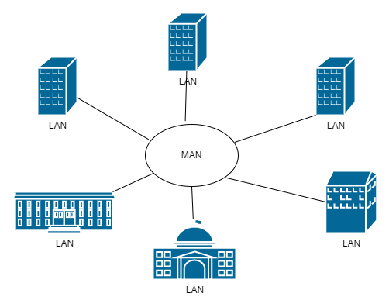
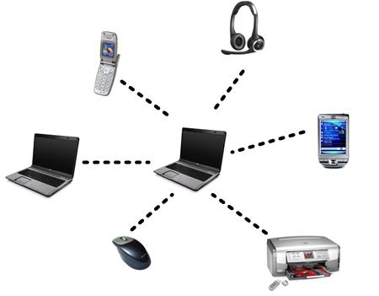
2.3 MAN (Metropolitan Area Network) – It’s commonly used in places like universities or campus across a city (Cisco, 2023).
2.4 PAN (Personal Area Network)- connects devices over a short distance, such as phones, smartwatches even Redco’s smart lighting and gates.
Notes:
The most common ones are LAN, WAN, and MAN. LAN, or Local Area Network, is used within a building—like in our case, for both the Kandy and Galle offices. Since both buildings are far apart in two different cities, I chose a WAN, or Wide Area Network, to connect the two LANs. This makes sure that both branches can communicate and share data securely over a wider distance.

Slide 6
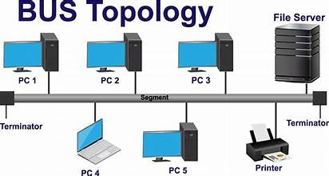
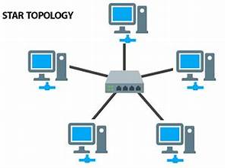
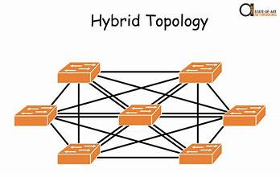
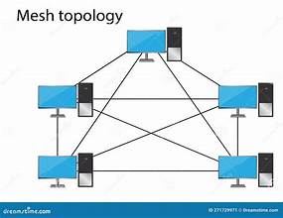
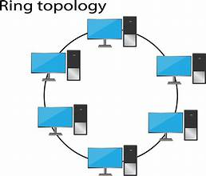
Network Topology
What is Network Topology?
The layout or structure of how devices are connected in a network
Types of Network Topology
Bus – Single cable backbone
Star – Devices connected to a central switch or router
Ring – Devices form a circle and data pass in one direction
Mesh – Devices are interconnected with each other
Hybrid – Mix of different topologies
Notes:
Network topology is basically how all the devices in a network are connected and how data flows between them.
Bus, where everything connects to a single cable,
Star, where each device connects to a central hub or switch,
Ring, where devices form a circle and pass data in one direction,
Mesh, where everything is connected to everything for high reliability, and
Hybrid, which combines two or more types.
For Redco, I chose a Star topology with a Hierarchical structure. Each floor has its own access switch that connects to a central switch or router. This makes the network easier to manage, isolate issues, and expand in the future as Redco adds more staff or devices.

Slide 7
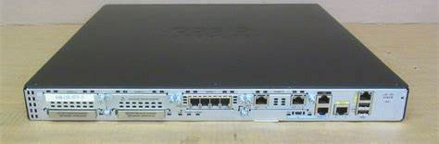
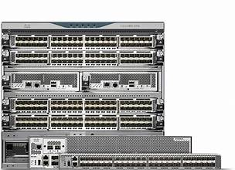
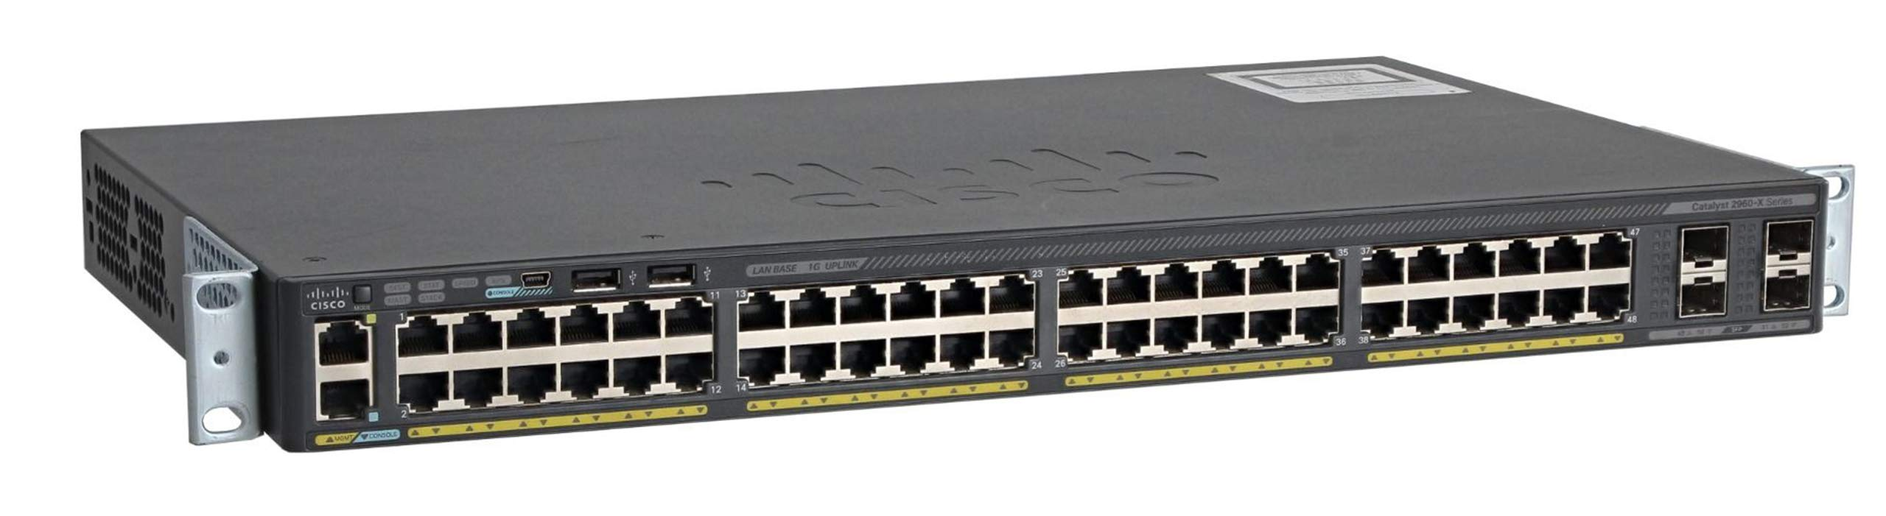
Devices and Tools Used in Redco Project
Network Devices:
Cisco Routers – are used to connect the Kandy and Galle branches. This helps both offices share data safely.
Layer 3 Switches – is a network device used for inter-VLAN routing and core switching, and it can also send data between networks
Access Switches (Layer 2) – For connecting PCs, printers, devices to the Redco network (Cisco, 2024).
Notes:
For Redco’s network, I selected devices based on the needs of both the Kandy HQ and the Galle branch.
Cisco Routers are used to connect the Kandy and Galle branches. This helps both offices share data safely.
Layer 3 Switches help different departments (VLANs) talk to each other inside the network. They also act like smart switches.
Layer 2 Access Switches connect PCs, printers, and other devices to the network on each floor.

Slide 8
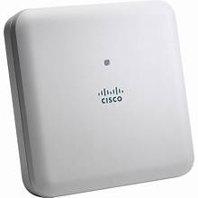
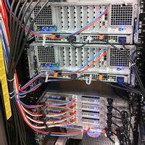
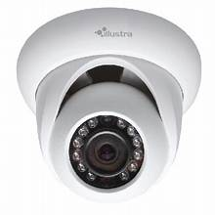
Cisco Access Points – give Wi-Fi access in areas like the reception, boardroom, and customer service area. These are secured with Wi-Fi passwords.
Servers – Hosting DHCP, DNS, File, ERP, and Backup services
IP Cameras – are used for security purposes in Galle, as they can be viewed from anywhere in the network.
Notes:
Cisco Access Points give Wi-Fi access in areas like the reception, boardroom, and customer service area. These are secured with Wi-Fi passwords.
Servers are used to give services like IP addresses (DHCP), website names (DNS), file storage, ERP, and backups.
IP Cameras are installed on both floors of the Galle branch to improve security. They can be viewed from anywhere on the network.
All these devices work together to make Redco’s network fast, secure, and easy to manage.

Slide 9
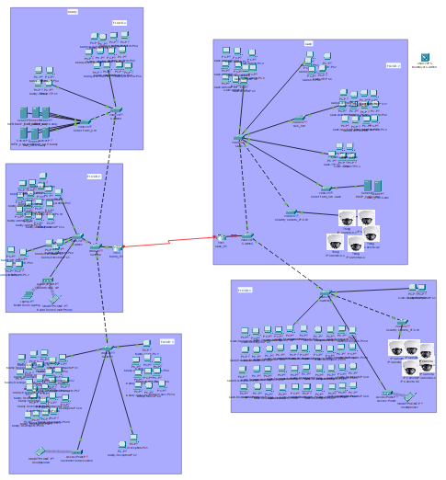
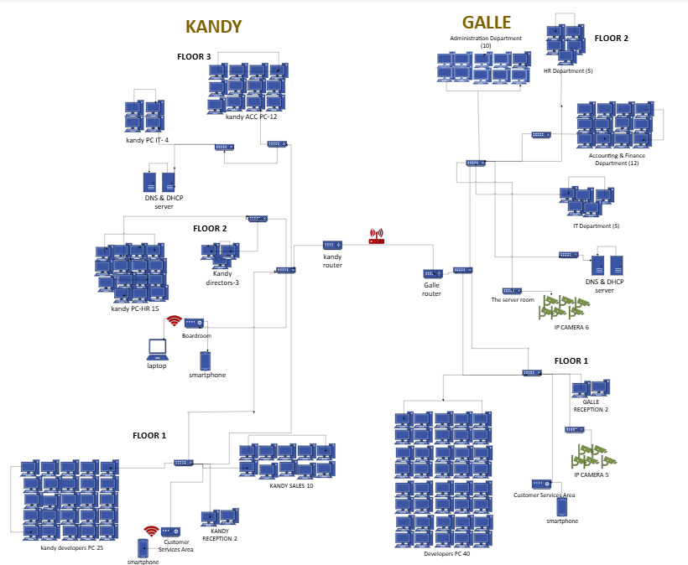
Software Tools for Redco project:
Cisco Packet Tracer – was the main simulation tool used for Network design and testing,
Microsoft Visio – was used to draw the full network design clearly
Notes:
To plan and test the network before implementation, I used different tools."
Cisco Packet Tracer was the main tool I used to build and test the network. It helped me connect PCs, servers, and routers, and set up the network across departments, floors, and branches.
Microsoft Visio was used to draw the full network design clearly. It includes all the devices like PCs, IP cameras, and routers, and shows how they are divided by floors and branches. This diagram helped me plan before building it in Packet Tracer.

Slide 10
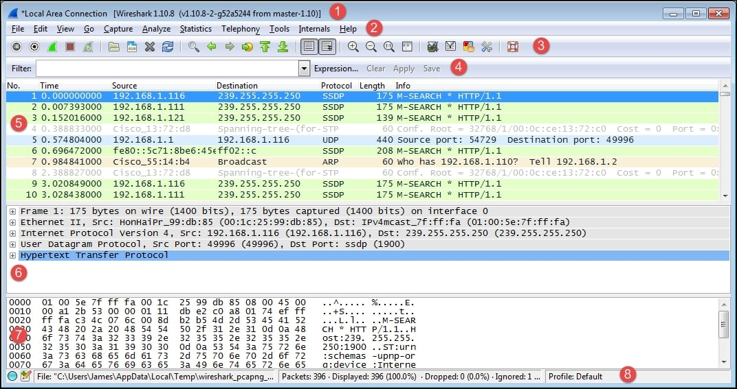
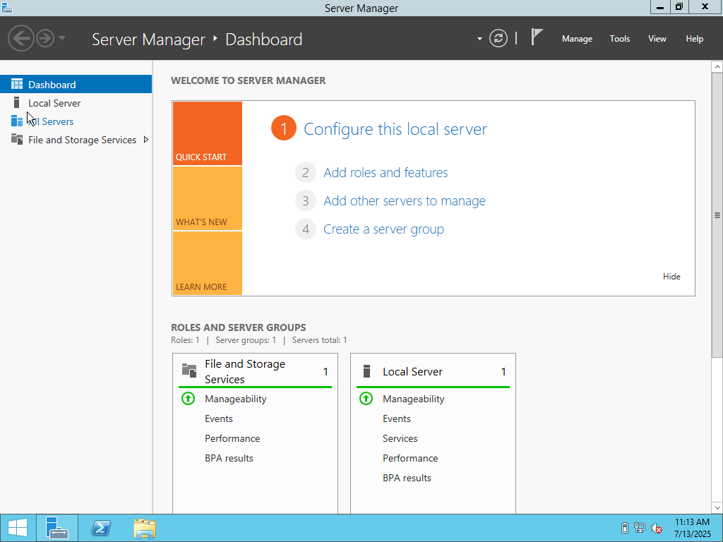
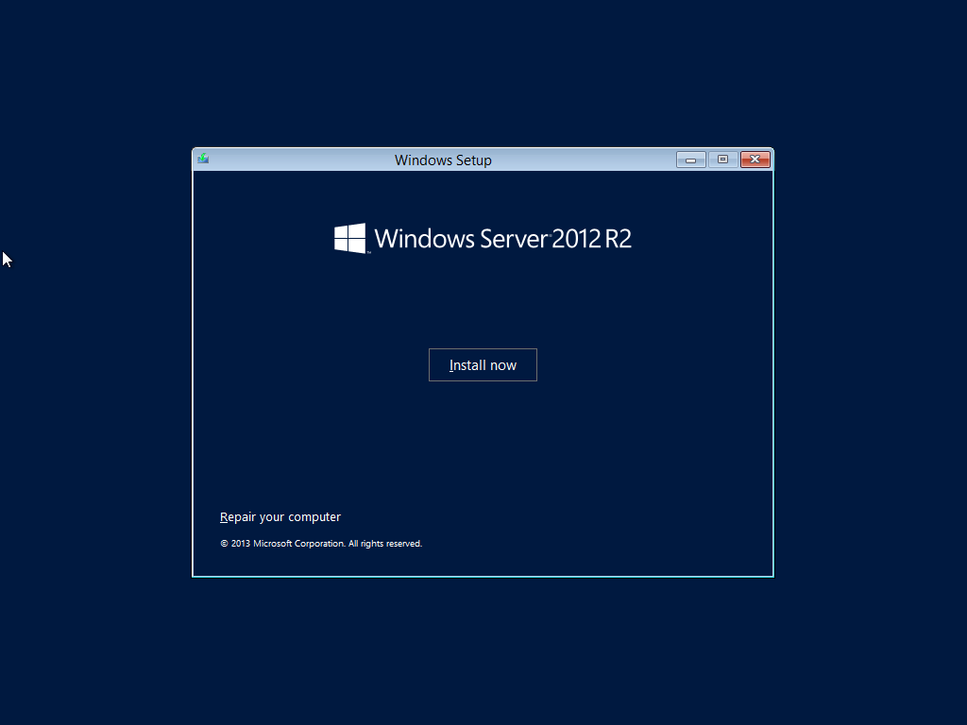
Wireshark – was used for analyzing network traffic troubleshooting them, and check data packets
Windows Server 2012 – was used to manage users, and helps control the whole network from one place
VirtualBox – was used for server roles like DHCP and DNS, and test how servers work, gives IP addresses and manages the network
Notes:
Wireshark helped me check the data packets in the network. I used it to make sure the network was working properly and that devices were talking to each other with no errors.
Oracle VirtualBox was used to make a virtual lab. In this lab, I installed Windows Server to test server roles like DHCP and DNS.
Windows Server 2012 used manage users and give network services like IP addresses (DHCP) and name resolution (DNS).
It helps control and manage the whole network from one place

Slide 11
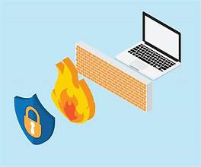
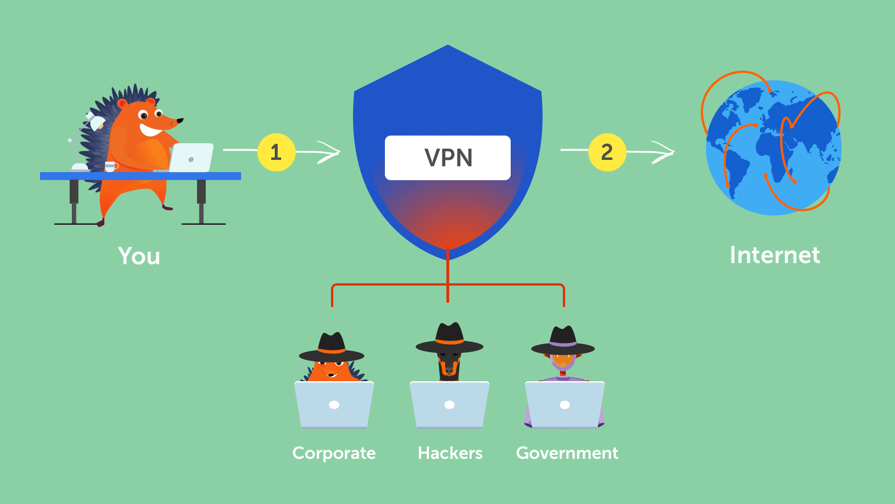
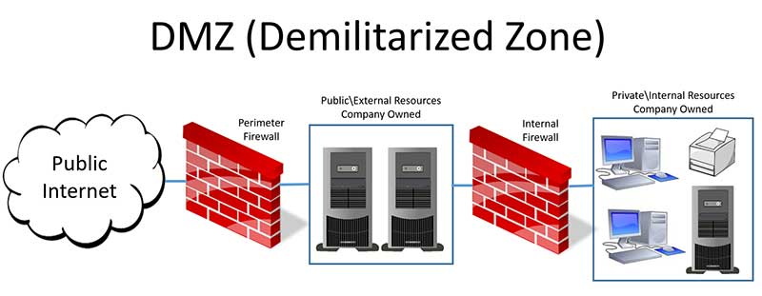
Security & Access Technologies in Redco’s Network
Firewall – Protects the network from unauthorized access
DMZ (Demilitarized Zone) – A DMZ is a small part of the network that protects the main network from outside threats
VPN (Virtual Private Network) – Enables secure remote access connection that lets employees safely access the Redco’s network from home.
Notes:
To protect Redco’s sensitive data and ensure secure communication between branches, I included key technologies like Firewalls, a DMZ, and VPNs.”
“A Firewall, A firewall is like a security guard. It blocks unwanted traffic and keeps the Redcos network safe from hackers, trying to access clients data
“I also added a DMZ, or Demilitarized Zone. This is where public-facing servers like the company website or email can sit—separated from the internal network—to reduce risk if they’re attacked.”
“A VPN lets remote employees or the Galle branch connect securely to the Kandy HQ. All the data sent over VPN is encrypted, so even if someone tries to intercept it, they won’t be able to read it.”
“These technologies help Redco operate securely, support growth, and keep their data safe—especially with remote access and future expansion in mind

Slide 12
Network Blueprint of Redco developments
The network diagram was made using Microsoft Visio.
It shows how the Kandy and Galle branch are linked using a WAN.
includes:
Routers
Switches
PCs
Servers
Access points.
Notes:
This is the network diagram I created for Redco Developments using Microsoft Visio. It shows how both the Kandy head office and Galle branch are connected through a WAN link.”
“Inside each location, I included all the important devices like routers, Layer 3 switches, wireless access points, servers, and end devices such as PCs and IP phones.”
“I also used VLANs to separate departments like HR, Finance, and Admin, which helps improve performance and security in the network.”
“This diagram helped me plan the structure of the network before I started the actual setup. It shows both the physical and logical layout, and it's useful for future updates or troubleshooting.”

Slide 13
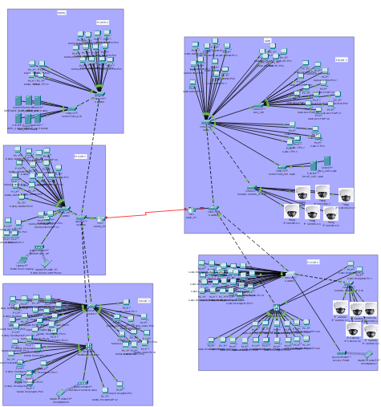
Cisco Packet Tracer Implementation
Cisco Packet Tracer was used to build a full network simulation for Redco.
It includes both Kandy and Galle, connected with routers.
Wireless access points was used for mobile devices
Network was tested using ping and traceroute to make sure everything works well.
Notes:
I used Cisco Packet Tracer to create a full simulation of Redco’s network, based on the Visio diagram I showed earlier.”
“The simulation includes the Kandy headquarters and the Galle branch, connected through a router-to-router WAN setup.”
“I configured VLANs for each department, enabled DHCP where needed, and assigned static IPs for critical devices like servers.”
“I also set up inter-VLAN routing and added wireless access points for mobile users and devices.”
“To make sure everything worked, I used ping and traceroute commands to test the connection between devices, VLANs, and even between branches.”
“This helped me confirm that the network is working correctly and ready for real-world deployment

Slide 14
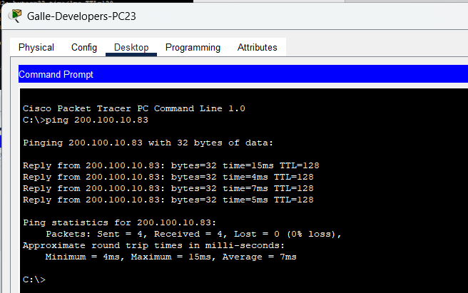
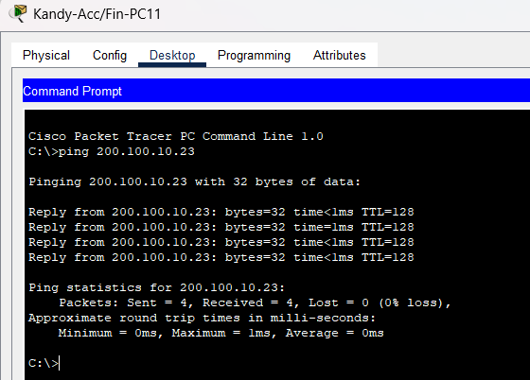
IP Ping Testing
What are Ping tests?
Ping tests are used to check if devices in the network can communicate with each other using their IP addresses (Network Encyclopedia, 2024).
Notes:
This slide shows the results of IP ping tests done between different PCs in the network.
By using the command prompt in Cisco Packet Tracer, I sent pings from one device to another to check if they could successfully communicate.
The replies in the screenshots show that the devices are properly connected and the network setup is working as expected.
It also confirms that the IP addresses have been assigned correctly and that the devices can reach each other over the network.

Slide 15
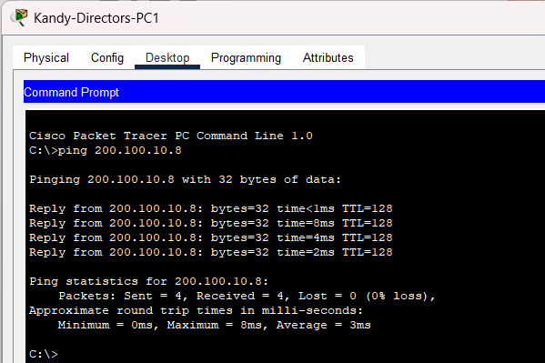
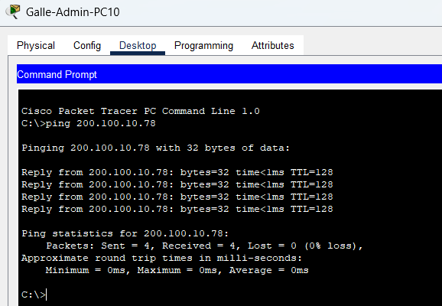
Successful replies mean the network is properly configured
IP pinging helps verify if two devices can communicate across the network
Used for testing both local and remote device connections.

Slide 16

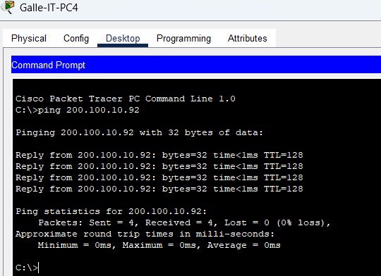
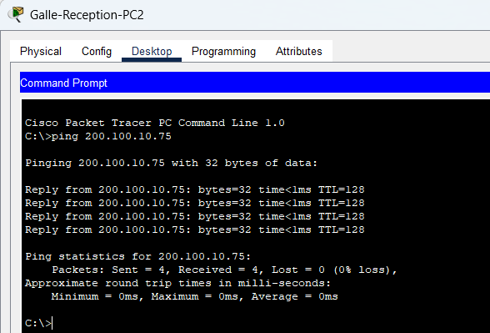
Packet Tracer Test Cases
What is a Test Case?
A test case is used to check if two devices in the network can talk to each other properly.
Test Case | Device used
Galle-Admin-PC2 | Galle-Admin-PC10
Galle-Acc/Fin-PC6 | Galle-Acc/Fin-PC8
Test Case | Device used
Galle-IT-PC1 | Galle-IT-PC4
Galle-Reception-PC1 | Galle-Reception-PC2
Notes:
In this test, I checked if devices inside the Galle branch can talk to each other properly.
I used ping in Packet Tracer to test communication between PCs in the same department.
For example, I pinged from Admin-PC2 to Admin-PC10 and also between PCs in Accounts, IT, and the Reception area.
Since all the devices are in the same VLAN, this test helps confirm that VLAN configuration, switching, and DHCP are working correctly.
All the ping tests were successful, which means the internal network is working fine and devices can share files or access services easily

Slide 17
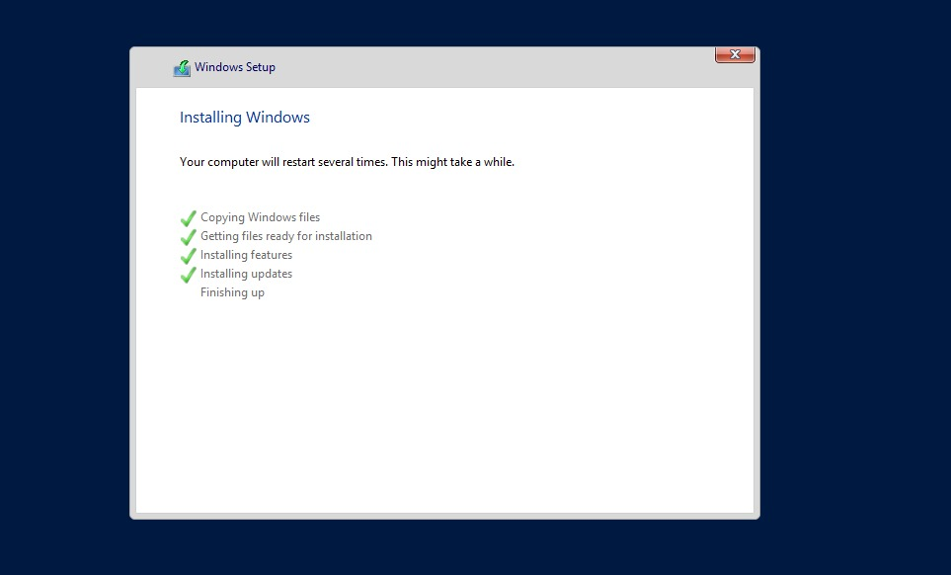
VirtualBox
Windows setup Server 2012 R2
The Windows Server 2012 R2 is selected and the setup process is beginning.
This screen shows the beginning of the installation
Windows installation in progress
Installing windows
The system is copying files and getting the server ready.

Slide 18
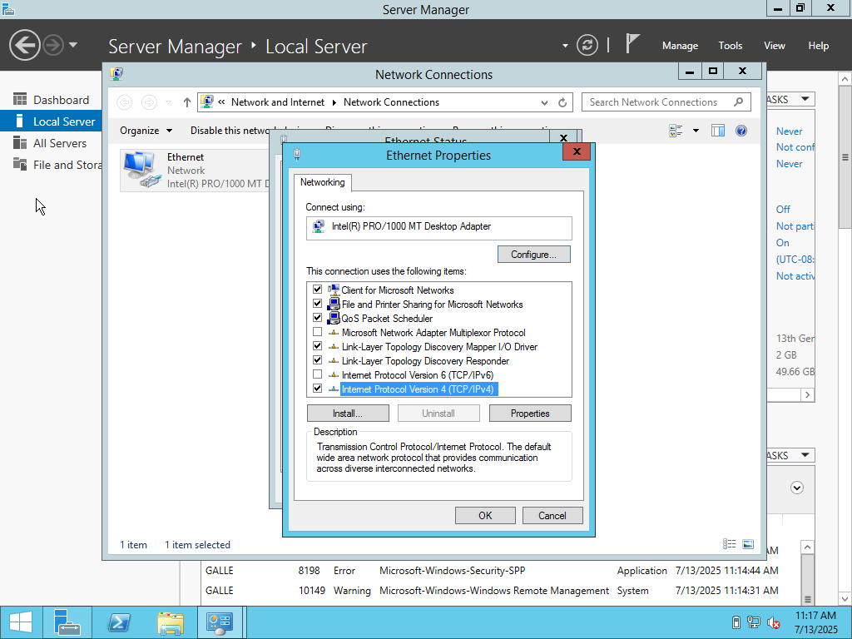
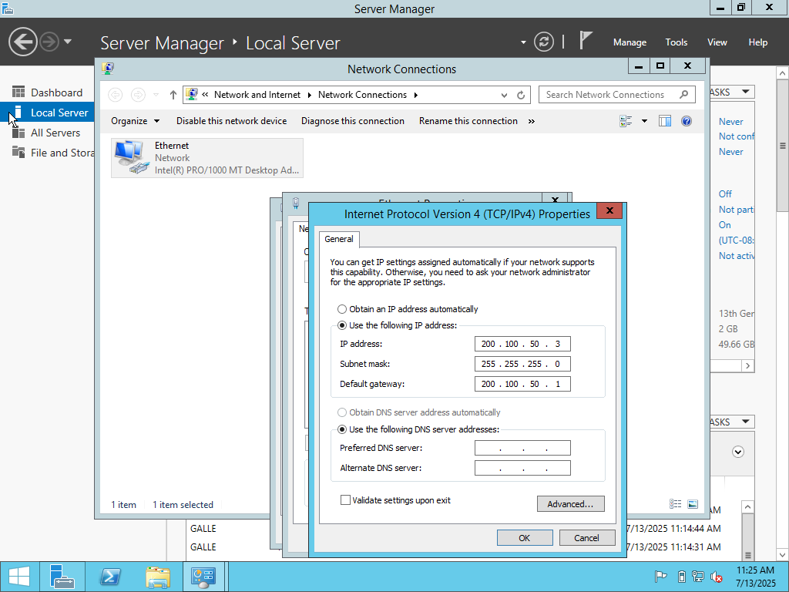
network protocol settings in ethernet properties
Opened Ethernet properties
Selected “Internet Protocol Version 4 (TCP/IPv4)”
setting IP address, subnet masks and default gateway
Entered: static IP address
subnet mask
default gateway
Helps server connect to the network correctly

Slide 19
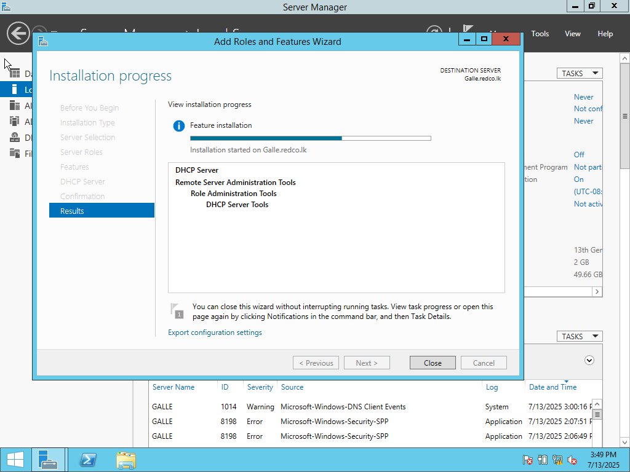
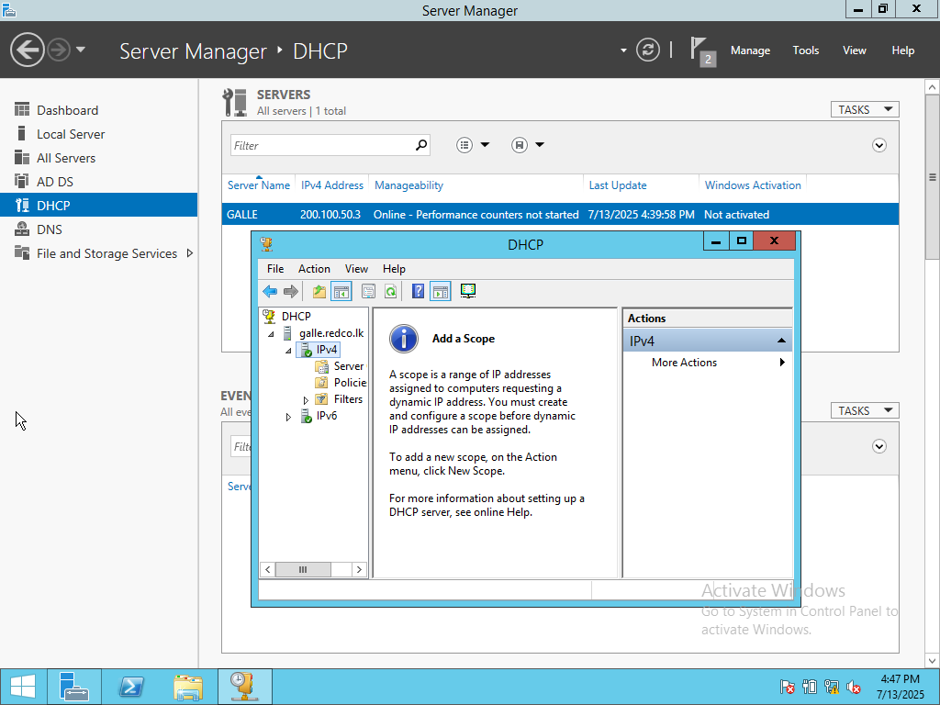
installing features for DHCP server
DHCP server is being installed
Its setting up the network service and prepares the server
adding a scope
setting up a DHCP scope
A scope makes IP assigning easier in the network

Slide 20
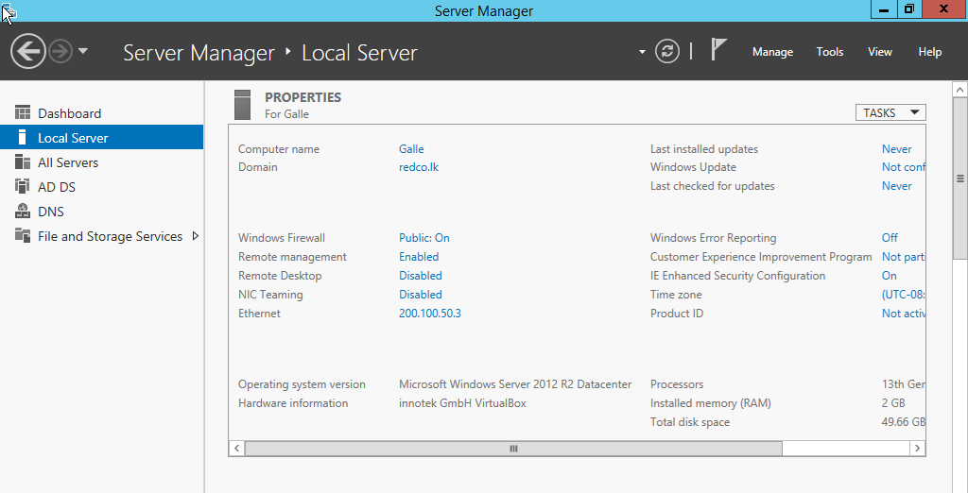
Active Directory Setup in VirtualBox
1. What is Active Directory (AD)?
AD is a directory service by Microsoft used to manage users, computers, and resources in a network, Using AD means we can manage all Redco’s users, passwords, and devices from one location (Microsoft, 2023)..
2. Installing and Setting up AD in VirtualBox
Windows Server 2019 installed in VirtualBox
Roles added: AD DS (Active Directory Domain Services)
Promoted to a Domain Controller
Domain Name Used: redco.lk
Notes:
Active Directory is like the brain of a Windows-based network. It stores all information about users, computers, and devices.
With AD, admins can easily control who can access what, apply security rules, and organize departments into units.
This is useful in companies like Redco to manage hundreds of users and apply settings from one place.
I installed Windows Server 2019 in VirtualBox and added the Active Directory Domain Services role.
Then, I promoted the server to a domain controller with the domain name redco.local.
This is the central point where users and devices will be managed.

Slide 21
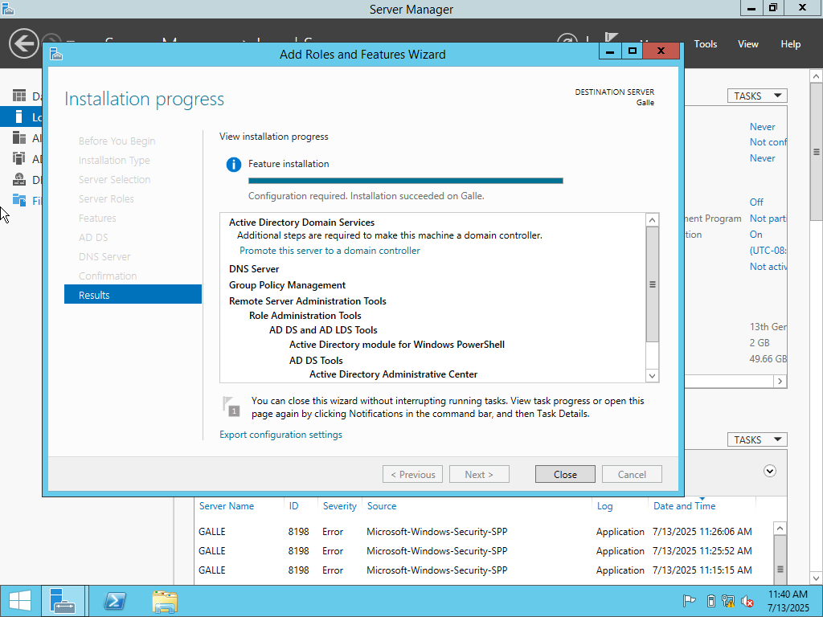
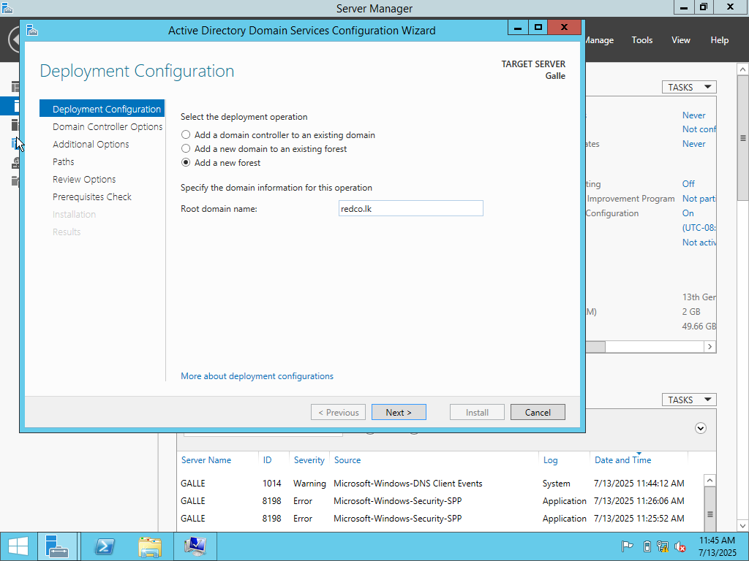
installing the Active Directory role on the server.
This step is important because it turns the server into a domain controller.
That means it can control user logins, manage devices, and apply security policies across the network.
After installing Active Directory, a new forest is being added
We typed redco.lk as the domain name.
This is the main identity for our network, and now all the computers and users will be part of this domain.

Slide 22
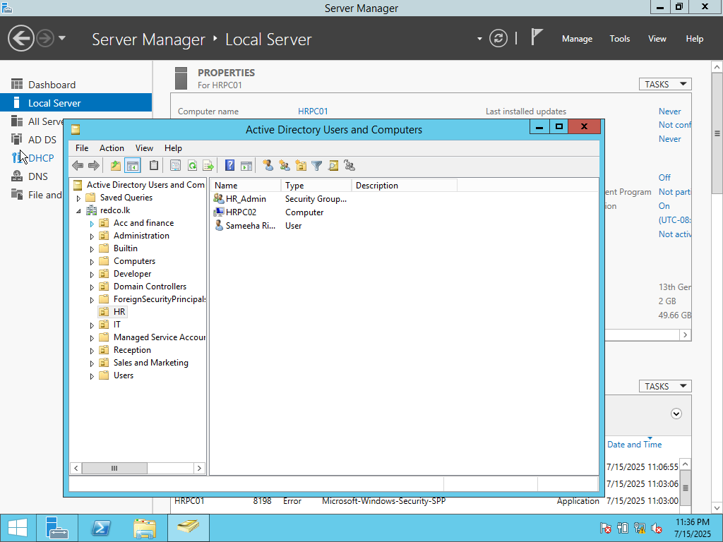
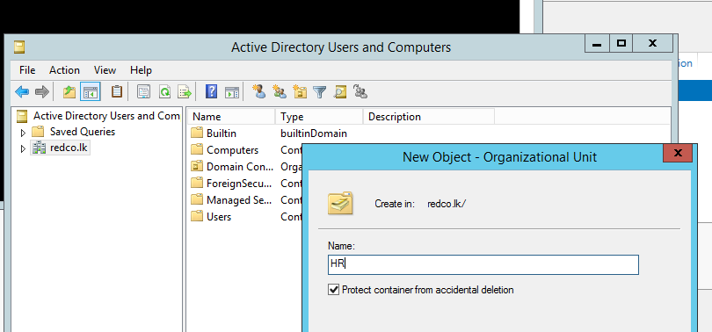
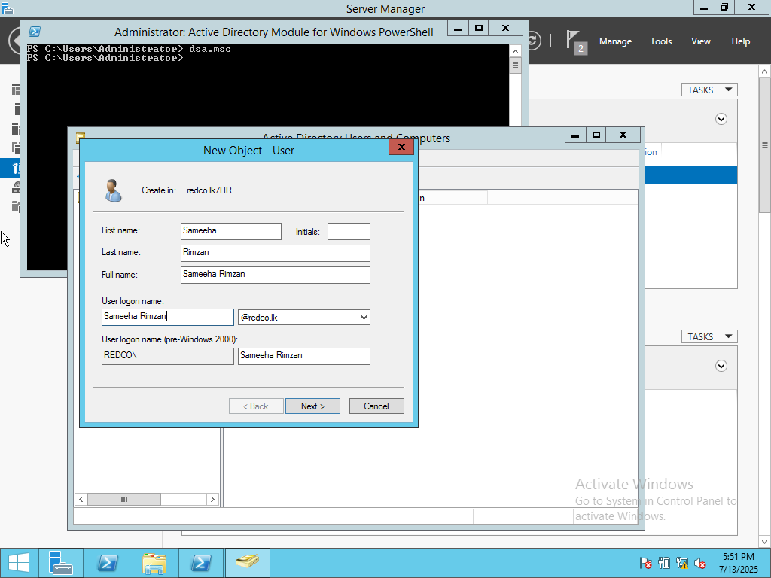
What are Organizational Units (OUs)?
Organizational Units are like folders inside Active Directory.
At Redco, we can use them to keep users and devices grouped
Then we can apply rules like password policies or software access
Creating Organizational Units (OUs) and Users
HR
IT
Developers
Sales and marketing
Reception
Added Users to each OU
Group Policies can be applied per OU
Notes:
I created OUs (Organizational Units) for each department, like HR, IT, Developers, and so on.
These help keep everything organized.
For example, I can apply different password policies or software restrictions to the IT OU without affecting others.
I also added users inside each OU to simulate the real Redco company setup.

Slide 23
References
TechTarget, 2023. Computer network. [online] Available at: https://www.techtarget.com/searchnetworking/definition/network [Accessed 21 Jul. 2025].
Cisco, 2023. Types of Networks: LAN, MAN, and WAN. [online] Available at: https://www.cisco.com/c/en/us/solutions/small-business/resource-center/networking/what-is-a-network.html [Accessed 21 Jul. 2025].
Cisco, 2024. Switches and Routers Explained. [online] Available at: https://www.cisco.com/c/en/us/products/switches/what-is-a-switch.html [Accessed 21 Jul. 2025]
Network Encyclopedia, 2024. Ping – Definition and Explanation. [online] Available at: https://networkencyclopedia.com/ping/ [Accessed 21 Jul. 2025
Microsoft, 2023. What is Active Directory?. [online] Available at: https://learn.microsoft.com/en-us/windows-server/identity/ad-ds/ad-ds-overview [Accessed 21 Jul. 2025]

Slide 24
Thank you for your time and attention!
Questions and Answers

